Slide 1
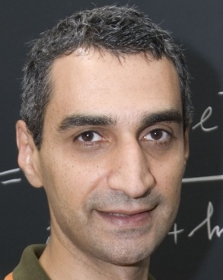





Finite size effects in superconducting grains: from theory to experiments
Antonio M. García-García
Phys. Rev. Lett. 100, 187001 (2008)
Sangita Bose, Tata, Max Planck Stuttgart
arXiv:0911.1559
Yuzbashyan Rutgers
Altshuler Columbia
Nature Materials
2768, May 2010
Kern Ugeda, Brihuega
Richter Regensburg
Urbina Regensburg

Slide 2
Main goals
1. Analytical description of a clean, finite-size non high T_{c} superconductor?
2. Are these results applicable to realistic grains?
3. Is it possible to increase the critical temperature?
L

Slide 3
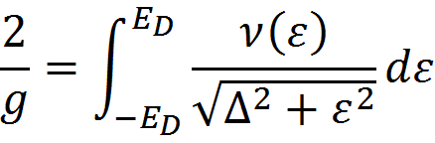
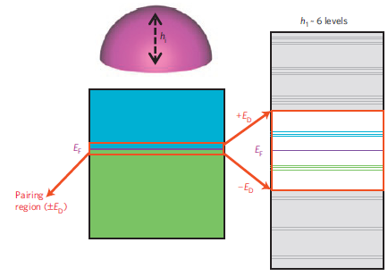
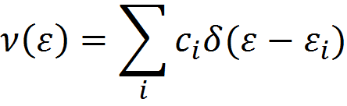

BCS superconductivity
Finite size effects
V → ∞ Δ~ ε_{D}e^{-1/λ}
V finite Δ=?
Can I combine this?
Is it already done?

Slide 4
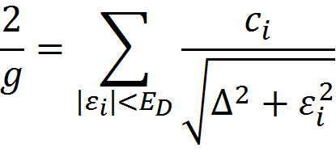


Brute force?
No practical for grains with no symmetry
ε_{i} = eigenvalues 1-body problem
Analytical?
1/k_{F} L <<1,
Semiclassical techniques
Quantum observables in terms of classical quantities Berry, Gutzwiller, Balian, Bloch

Slide 5
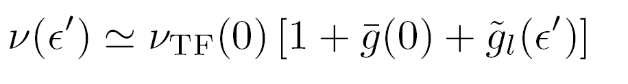
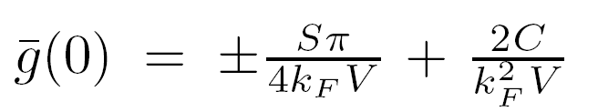
Expansion 1/k_{F}L << 1
Non oscillatory terms
Weyl’s expansion
Oscillatory terms in L, ε
Gutzwiller’s trace formula

Slide 6
Are these effects important?
Δ₀ Superconducting gap
L typical length
δ Mean level spacing
l coherence length
ε_{F} Fermi Energy
ξ SC coherence length
Conditions
BCS δ/ Δ₀ << 1
Semiclassical1/k_{F}L << 1
Quantum coherence l >> L ξ >> L
For Al the optimal region is L ~ 10nm

Slide 7

Is it done already?
Go ahead!
This has not been done before
Is it realistic?
Corrections to BCS smaller or larger?
In what range of parameters?
Let’s think about this

Slide 8
A little history
Superconductivity in particular geometries
Parmenter, Blatt, Thompson (60’s) : BCS in a rectangular grain
Heiselberg (2002): BCS in harmonic potentials, cold atom appl.
Shanenko, Croitoru (2006): BCS in a wire
Devreese (2006): Richardson equations in a box
Kresin, Boyaci, Ovchinnikov (2007) Spherical grain, high T_{c}
Olofsson (2008): Estimation of fluctuations in BCS, no correlations

Slide 9
Nature of superconductivity (?) in ultrasmall systems
Breaking of superconductivity for δ/ Δ₀ > 1? Anderson (1959)
Estimation. No rigorous!
Thermodynamic properties
Muhlschlegel, Scalapino (1972)
Description beyond BCS
Experiments
Tinkham et al. (1995). Guo et al., Science 306, 1915, “Supercond. Modulated by quantum Size Effects.”
Even for δ/ Δ₀ ~ 1 there is “supercondutivity
1.Richardson’s equations: Good but Coulomb, phonon spectrum?
2.BCS fine until δ/ Δ₀ ~ 1/2
T = 0 and δ/ Δ₀ > 1 (1995-) Richardson, von Delft, Braun, Larkin, Sierra, Dukelsky, Yuzbashyan

Slide 10
δ/ Δ₀ >> 1
No systematic BCS treatment of the dependence of size and shape
We are in business!
?

Slide 11




Hitting a bump
1-body eigenstates
I = 1/V + ...?
Matrix elements?
I ~1/V?
Chaotic grains?

Slide 12

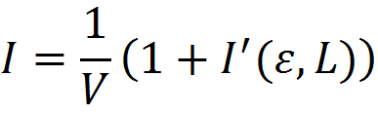

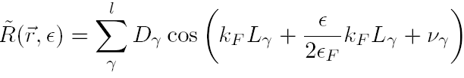
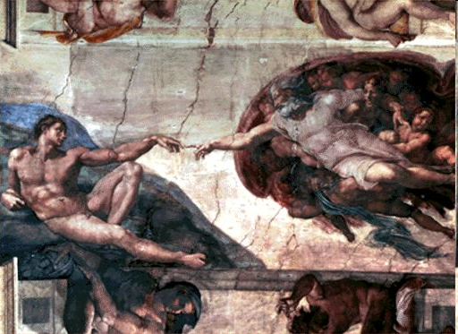
From desperation to hope
Semiclassical expansion for I
?
Yes, with help, we can

Slide 13


Regensburg, we have got a problem!!!
Do not worry. It is not an easy job but you are in good hands
Nice closed results that do not depend on the chaotic cavity
For l>>L maybe we can use ergodic theorems
f(L,ε- ε’, ε_{F}) is a simple function

Slide 14
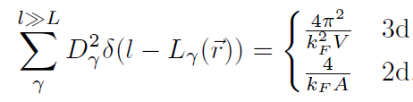

Semiclassical (1/k_{F}L >> 1) expansion for l !!
Classical ergodicity of chaotic systems
Sieber 99, Ozoiro Almeida, 98
ω = ε-ε’
Relevant in any mean field approach with chaotic one body dynamics

Slide 15
Now it is easy

Slide 16



3d chaotic
ξ controls (small) fluctuations
Boundary conditions
Universal function
Enhancement of SC!

Slide 17
3d chaotic
Al grain
k_{F} = 17.5 nm⁻¹
Δ₀ = 0.24mV
L = 6nm, Dirichlet, δ/Δ₀=0.67
L= 6nm, Neumann, δ/Δ_{0,}=0.67
L = 8nm, Dirichlet, δ/Δ₀=0.32
L = 10nm, Dirichlet, δ/Δ₀,= 0.08
For L< 9nm leading correction comes from I(ε,ε’)

Slide 18
3d integrable
Numerical & analytical
Cube & rectangle

Slide 19
From theory to experiments
L ~ 10 nm Sn, Al…
Is it taken into account?
Real (small) Grains
No, but screening should be effective
Coulomb interactions
No, but no strong effect expected
Surface Phonons
Deviations from mean field
Yes
Decoherence
Yes
Fluctuations
No

Slide 20

Mesoscopic corrections versus corrections to mean field
Finite size corrections to BCS
Matveev-Larkin
Pair breaking Janko,1994
The leading mesoscopic corrections contained in Δ(0) are larger
The correction to Δ(0) proportional to δ has different sign

Slide 21
Experimentalists are coming
Sorry but in Pb only small fluctuations
Are you 300% sure?
arXiv:0904.0354v1

Slide 22
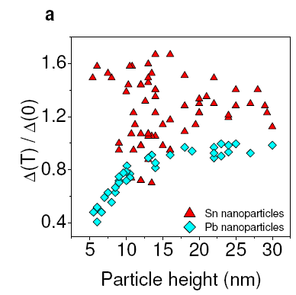
However in Sn is very different
!!!!!!!!!!!!!!!!!!!!!!!!!!!!!
Pb and Sn are very different because their coherence lengths are very different.

Slide 23
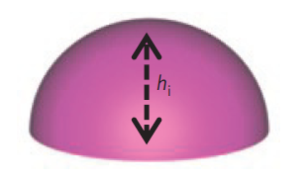
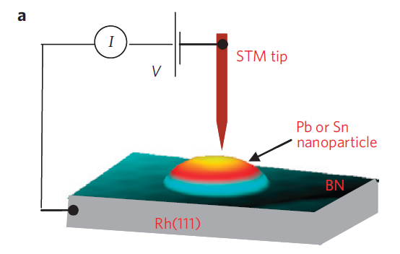
Single isolated Pb, Sn
h= 4-30nm
B closes gap
Almost hemispherical
Experimental output
Tunneling conductance

Slide 24
dI/dV

Slide 25
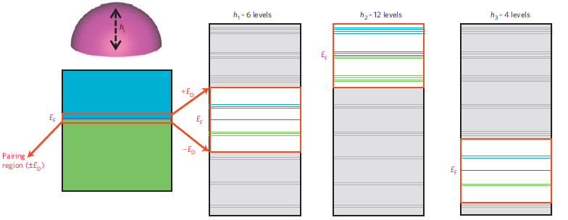
Grain symmetry
Level degeneracy
Enhancement of fluctuations
Shell effects
More
states around ε_{F}
Larger gap

Slide 26
+

Slide 27
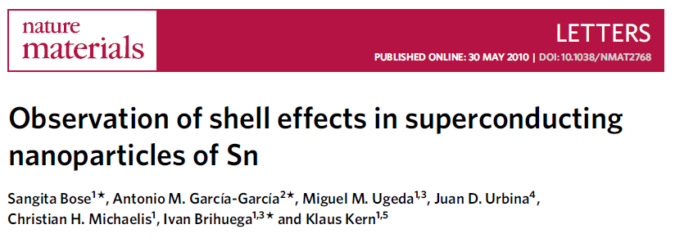
7 nm
0 nm

Slide 28
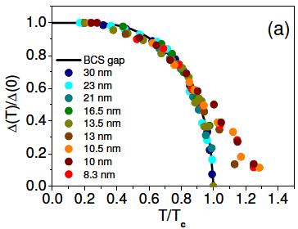
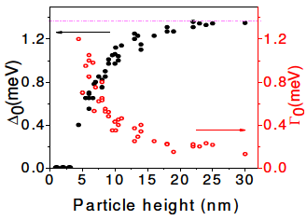
Do you want
more fun?
Why not
Pb
Physics beyond mean-field
Δ(T) > 0 for T > T_{c}
Δ(0) ↓↓ for L < 10nm

Slide 29
Theoretical dI/dV
dI/dV
Dynes formula
?
Beyond Dynes
Fluctuations + BCS Finite size effects + Deviations from mean field

Slide 30
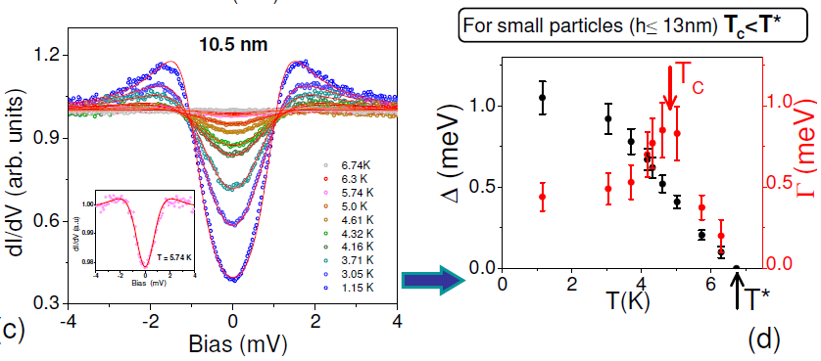
Dynes fitting
Γ > Δ
Breaking of mean field
Γ no monotonic

Slide 31
Pb L < 10nm
Strongly coupled SC
Eliashberg theory
Scattering, recombination, phonon spectrum
Thermal fluctuations δ/T_{c}
Path integral
Static path approach
Quantum fluctuations δ/Δ,E_{D}
Richardson equations
Exact solution,
Exact solution, BCS Hamiltonian
Finite-size corrections
Semiclassical
Previous part

Slide 32
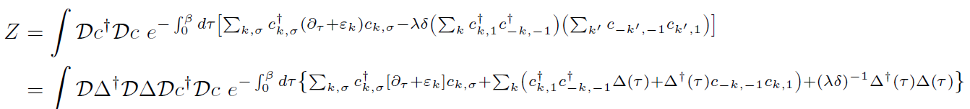

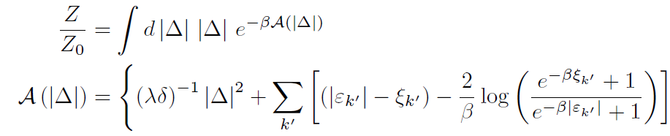
Thermal fluctuations
Path integral
Hubbard-Stratonovich transformation
Static path approach
0d grains
Δ homogenous
Scalapino et al.

Slide 33
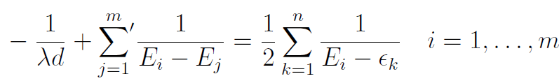


Other
deviations from mean field
Richardson’s equations
Path integral?
Too difficult!
Even worse!
BCS eigenvalues
Pair breaking excitation
OK expansion in δ/Δ₀ !
But
Richardson, Yuzbashyan, Altshuler

Slide 34
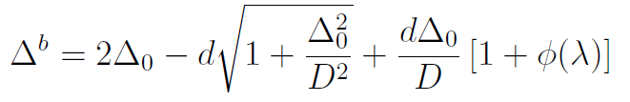
Pair breaking energy
Energy gap Δ
D ≡ E_{D}
d ≡ δ
Blocking effect
Quantum fluctuations
>>
Remove two levels closest to E_{F}
Only important δ~Δ~L<5nm

Slide 35
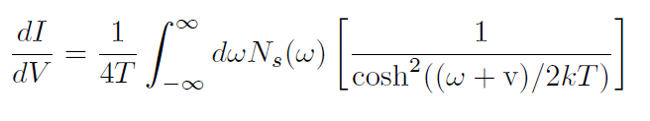
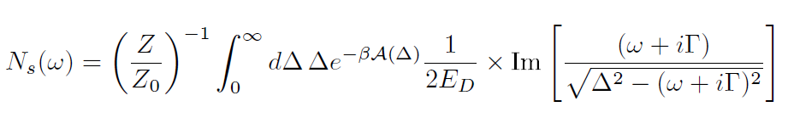
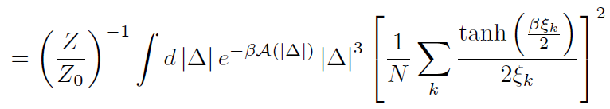

Putting everything together
Tunneling conductance
Eliashberg
Energy gap

Slide 36

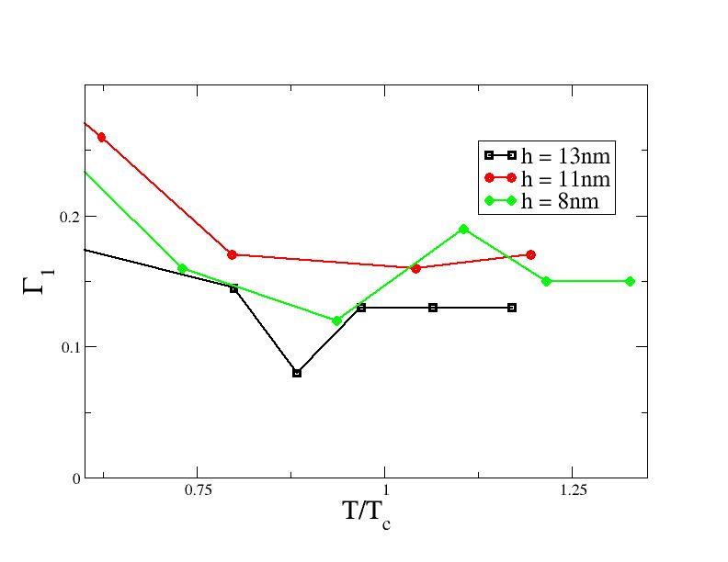
Finite T ~ T_{c}
Thermal fluctuations
Static Path Approach
BCS finite size effects
Part I
Deviations from BCS
Richardson formalism
λ(T), Γ(T) from data
Γ(T~T_{c})~ weak T dep

Slide 37
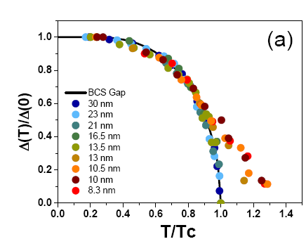

Slide 38
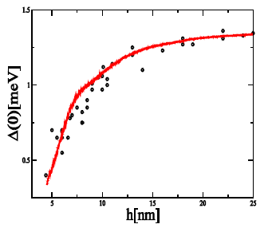

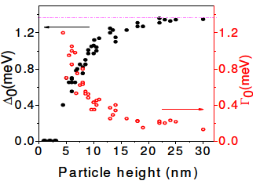
T=0
Dynes is fine h>5nm
BCS finite size effects
Part I
Deviations from BCS
Richardson formalism
No fluctuations!
Not important h > 5nm
λ(L) ~ λ_{bulk} from data

Slide 39
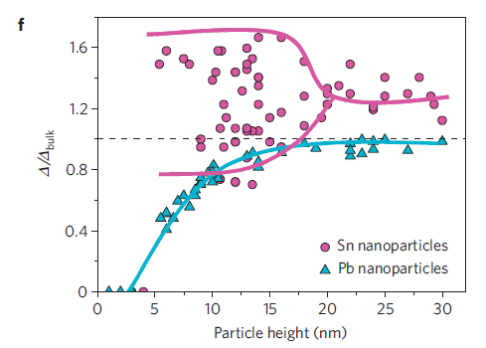
What is next?
1. Why enhancement in average Sn gap?
2. High T_{c} superconductors
High energy techniques
1 ½ . Strong interactions

Slide 40
THANKS!

Slide 41
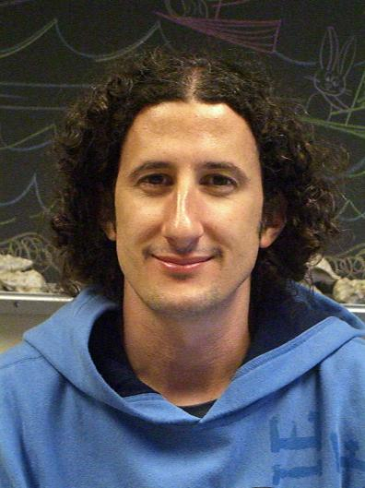

Holographic techniques in condensed matter
AdS-CFT correspondence
Maldacena’s conjecture
Strongly coupled field theory
A solution looking for a problem
Weakly coupled gravity dual
N=4 Super-Yang Mills
CFT
Anti de Sitter space
AdS
2003
QCD Quark gluon plasma
Gubser, Son
2008
Condensed matter
Hartnoll, Herzog
Applications in high Tc superconductivity
Powerful tool to deal with strong interactions
Franco
Santa Barbara
Rodriguez
Princeton
Transition from qualitative to quantitative
JHEP 1004:092 (2010)
Phys. Rev. D 81, 041901 (2010)

Slide 42
Problems
1. Estimation of the validity of the AdS-CFT approach
2. Large N limit
For what condensed matter systems are these problems minimized?
Phase Transitions triggered by thermal fluctuations
Why?
1. Microscopic Hamiltonian is not important
2. Large N approximation OK

Slide 43
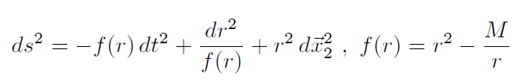



Holographic approach to phase transitions
Phys. Rev. D 81, 041901 (2010)
1. d=2+1 and AdS₄ geometry
2. For c₃ = c₄ = 0 mean field results
3. Gauge field A is U(1) and Ψ is a scalar
4. The dual CFT (quiver SU(N) gauge theory) is known for some ƒ
5. By tuning ƒ we can reproduce different phase transitions

Slide 44
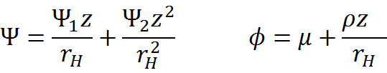


How are results obtained?
1. Einstein equations for the scalar and electromagnetic field
2. Boundary conditions from the AdS-CFT dictionary
Boundary
Horizon
3. Scalar condensate of the dual CFT

Slide 45

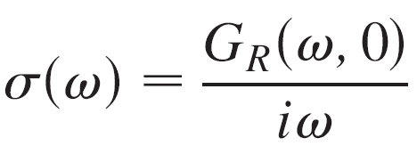
Calculation of the conductivity
1. Introduce perturbation in the bulk
2. Solve the equation of motion
Boundary
with boundary conditions
Horizon
3. Find retarded Green Function
4. Compute conductivity

Slide 46
Results I
For c₄ > 1 or c₃ > 0 the transition becomes first order
A jump in the condensate at the critical temperature is clearly observed for c₄ > 1
The discontinuity for c₄ > 1 is a signature of a first order phase transition.

Slide 47
Results II
Second order phase transitions with non mean field critical exponents different are also accessible
1. For c₃ < -1
2. For
Condensate for c_{α} = -1 and c₄ = ½. β = 1, 0.80, 0.65, 0.5 for α = 3, 3.25, 3.5, 4, respectively

Slide 48
Results III
The spectroscopic gap becomes larger and the coherence peak narrower as c₄ increases.

Slide 49
Future
1. Extend results to β <1/2
2. Adapt holographic techniques to spin
3. Effect of phase fluctuations. Mermin-Wegner theorem?
4. Relevance in high temperature superconductors

Slide 50







E. Yuzbashyan, Rutgers
B. Altshuler
Columbia
JD Urbina
Regensburg
S. Bose
Stuttgart
M. Tezuka
Kyoto
K. Richter
Regensburg
Let’s do it!!
P. Naidon
Tokyo
K. Kern,
Stuttgart
S. Franco,
Santa Barbara
D. Rodriguez
Queen Mary
J. Wang
Singapore

Slide 51
